Slide 1
Deep Reinforcement Learning for Active High Frequency Trading
Master Student: Jeng-Cheng Chang
Advisor: Dr. Katherine Shu-Min Li
EDA&T Lab.
Dept. of Computer Science and Engineering National Sun Yat-Sen University, Kaohsiung, TAIWAN

Slide 2
Author
Antonio Briola, Jeremy Turiel
Department of Computer Science
University College London, London, UK

Slide 3
Outline
Background
Methods
Results and Discussion
Conclusions

Slide 4
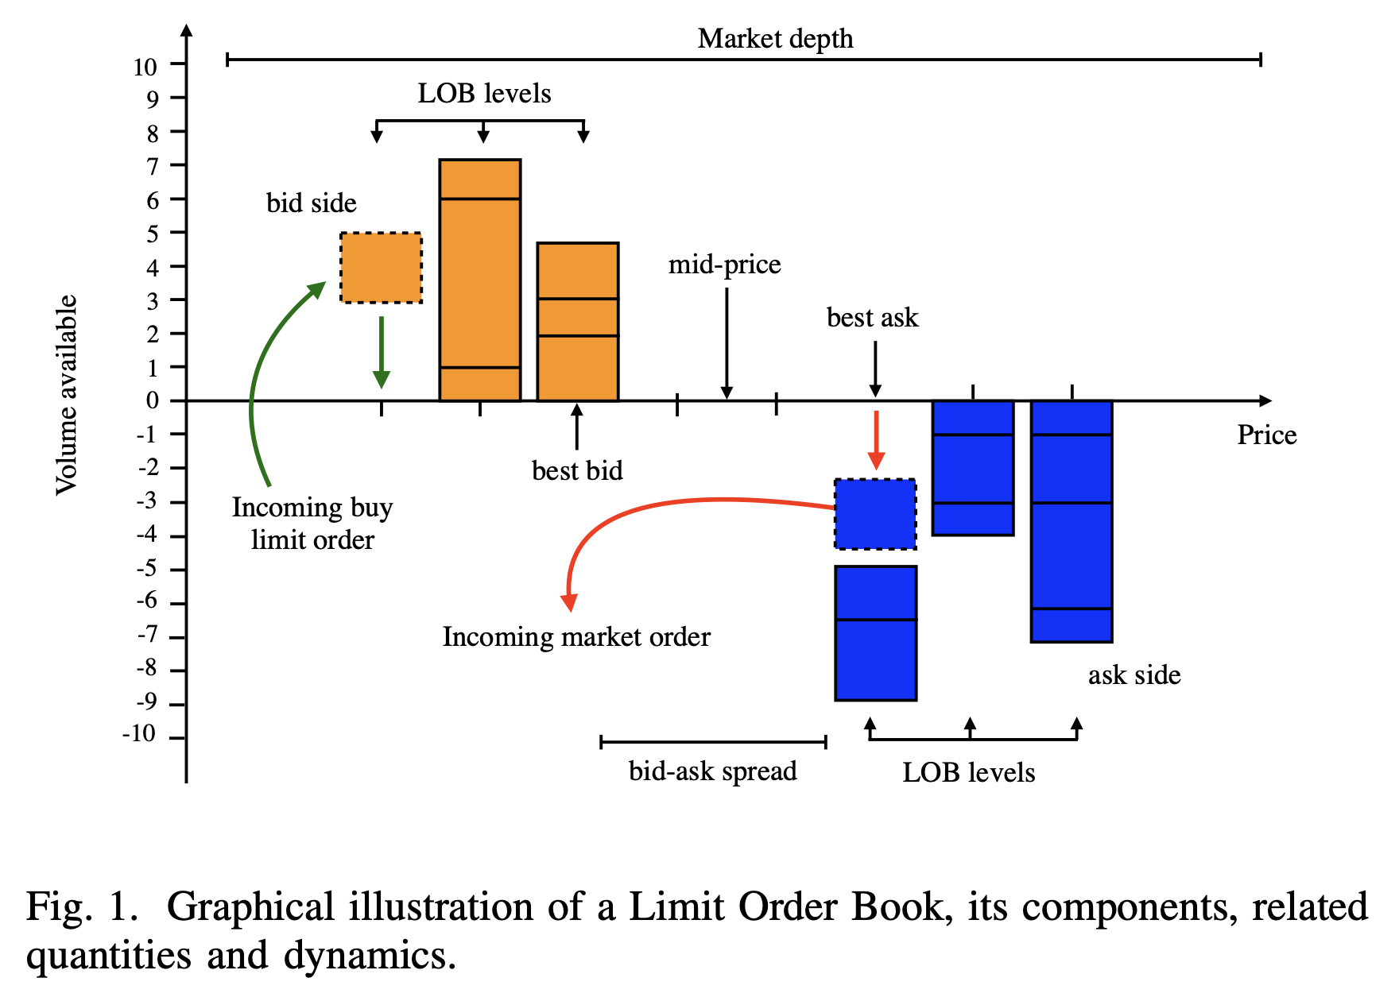
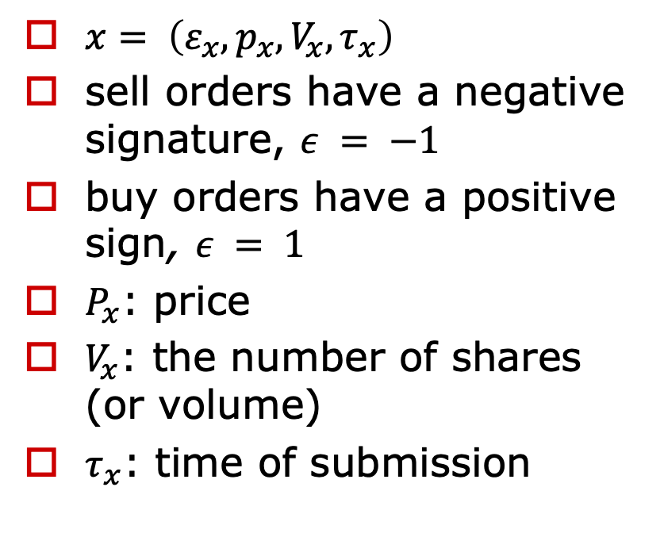
Background - Limit Order Book
$x= \left(ε_{x}, p_{x}, V_{x}, τ_{x}\right)$
sell orders have a negative signature, $ε = −1$
buy orders have a positive sign, $ε = 1$
$P_{x}$: price
$V_{x}$: the number of shares (or volume)
$τ_{x}$: time of submission

Slide 5
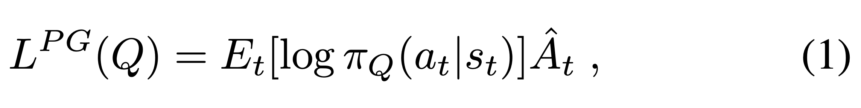
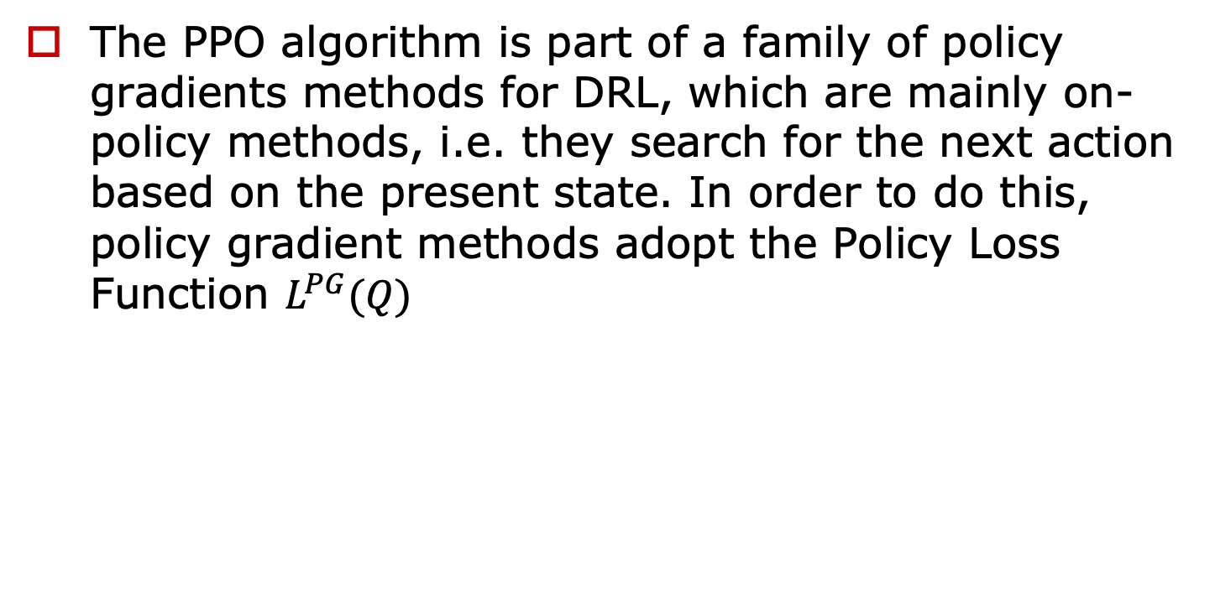

Background – PPO (1/3)
The PPO algorithm is part of a family of policy gradients methods for DRL, which are mainly on-policy methods, i.e. they search for the next action based on the present state. In order to do this, policy gradient methods adopt the Policy Loss Function $L^{PG}(Q)$
$E_{t}[ \log{π_{Q}(a_{t}|s_{t})]}$: probability of taking action
${\hat{A}}_{t}$: estimated Advantage function

Slide 6
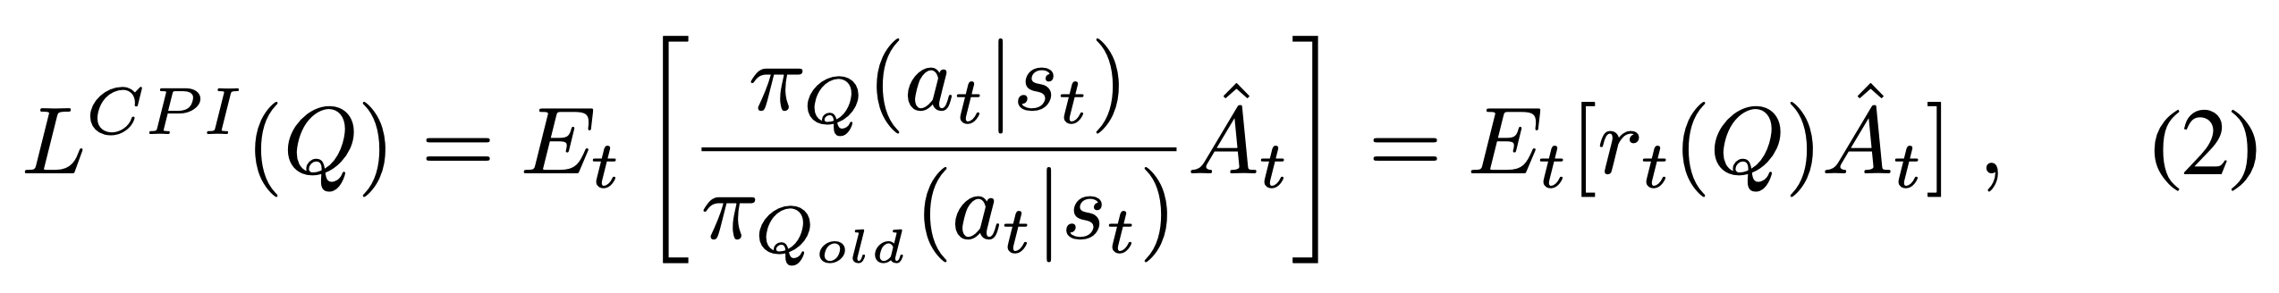
Background – PPO (2/3)
PPO methods ensure the stability of the policy update process by directly controlling the size of the gradient ascent step implied by the Policy Loss Function. In order to do this, the objective function is written as per Equation 2
$π_{Q}(a_{t}|s_{t})$: probability of action under the current policy
$π_{Q_{old}}(a_{t}|s_{t})$: probability of action under the previous policy

Slide 7
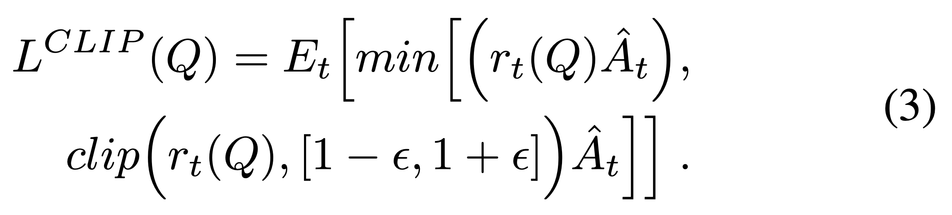
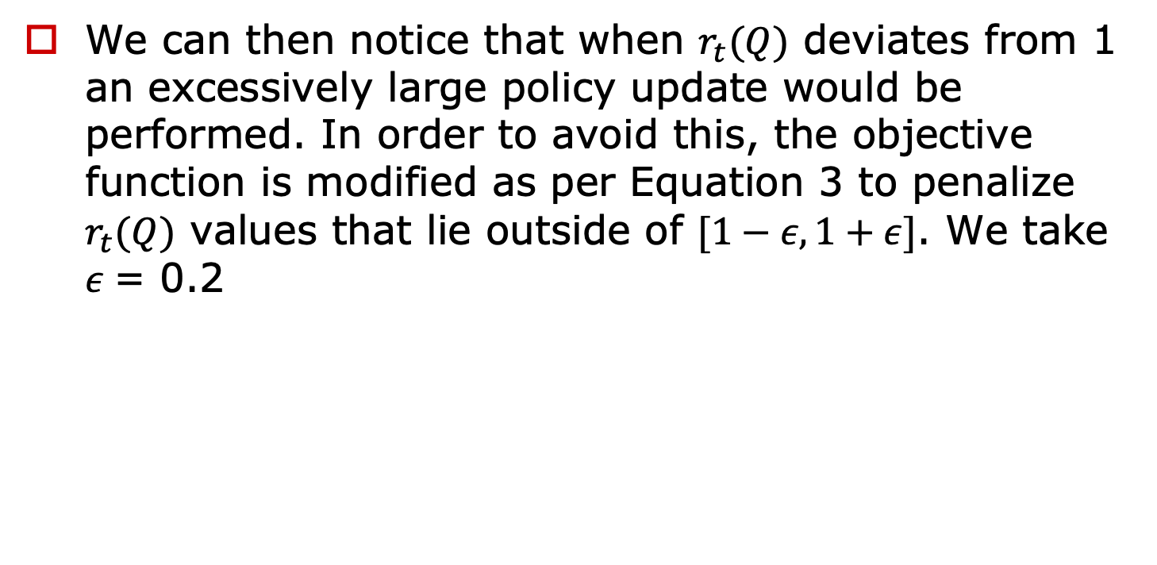
Background – PPO (3/3)
We can then notice that when $r_{t}(Q)$ deviates from 1 an excessively large policy update would be performed. In order to avoid this, the objective function is modified as per Equation 3 to penalize $r_{t}(Q)$ values that lie outside of $[1−ε,1+ε]$. We take $ε$= 0.2
$ε$: 超參數
[7] J. Schulman, F. Wolski, P. Dhariwal, A. Radford, and O. Klimov, “Proximal policy optimization algorithms,” arXiv preprint arXiv:1707.06347, 2017.

Slide 8
Methods - Data
reconstructed LOB of Intel Corporation’s stock (INTC)
training dataset consists of 60 files (one per trading day between 04-02-2019 and 30-04-2019)
validation dataset consists of 22 (one per trading day between 01-05- 2019 and 31-05-2019)
test dataset consists of 20 files (one per trading day between 03-06-2019 and 28-06-2019)

Slide 9
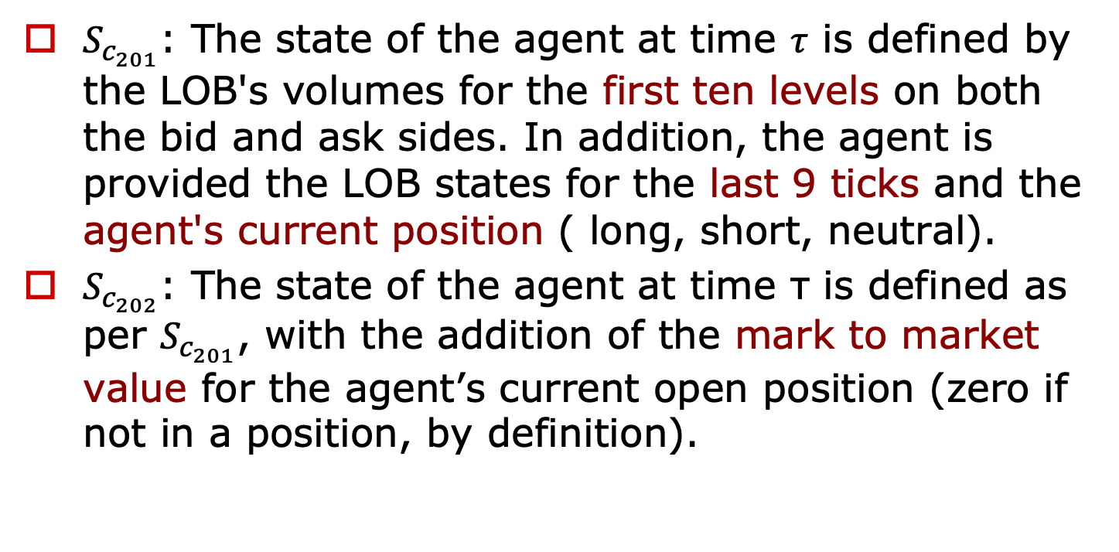
Methods – Models (1/5)
$S_{c_{201}}$: The state of the agent at time $τ$ is defined by the LOB's volumes for the first ten levels on both the bid and ask sides. In addition, the agent is provided the LOB states for the last 9 ticks and the agent's current position ( long, short, neutral).
$S_{c_{202}}$: The state of the agent at time τ is defined as per $S_{c_{201}}$, with the addition of the mark to market value for the agent’s current open position (zero if not in a position, by definition).

Slide 10
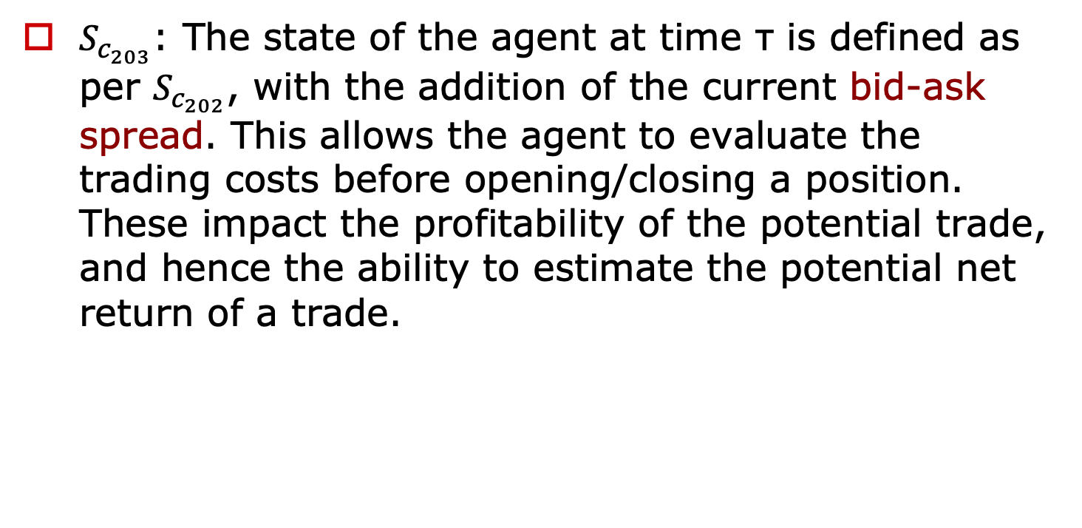
Methods – Models (2/5)
$S_{c_{203}}$: The state of the agent at time τ is defined as per $S_{c_{202}}$, with the addition of the current bid-ask spread. This allows the agent to evaluate the trading costs before opening/closing a position. These impact the profitability of the potential trade, and hence the ability to estimate the potential net return of a trade.

Slide 11
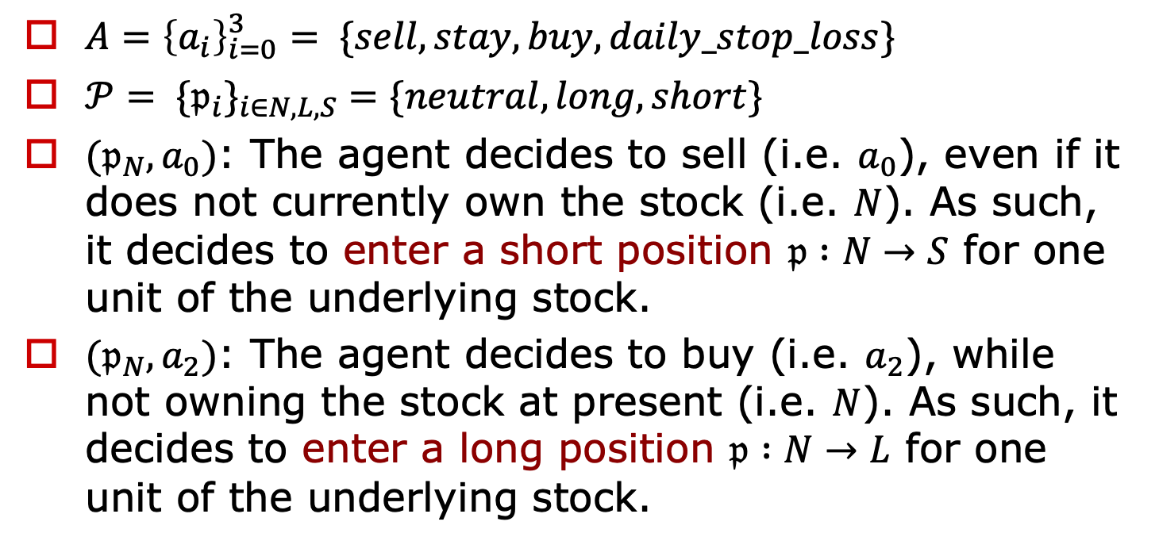
Methods – Models (3/5)
$A={\left\{a_{i}\right\}}_{i=0}^{3}= \{sell, stay, buy, daily_stop_loss\}$
$𝒫= \{𝔭_{i}\}_{i∈N,L,S}=\{neutral,long,short\}$
$(𝔭_{N},a_{0})$: The agent decides to sell (i.e. $a_{0}$), even if it does not currently own the stock (i.e. $N$). As such, it decides to enter a short position $𝔭 :N→S$ for one unit of the underlying stock.
$(𝔭_{N},a_{2})$: The agent decides to buy (i.e. $a_{2}$), while not owning the stock at present (i.e. $N$). As such, it decides to enter a long position $𝔭 :N→L$ for one unit of the underlying stock.

Slide 12
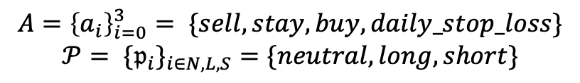
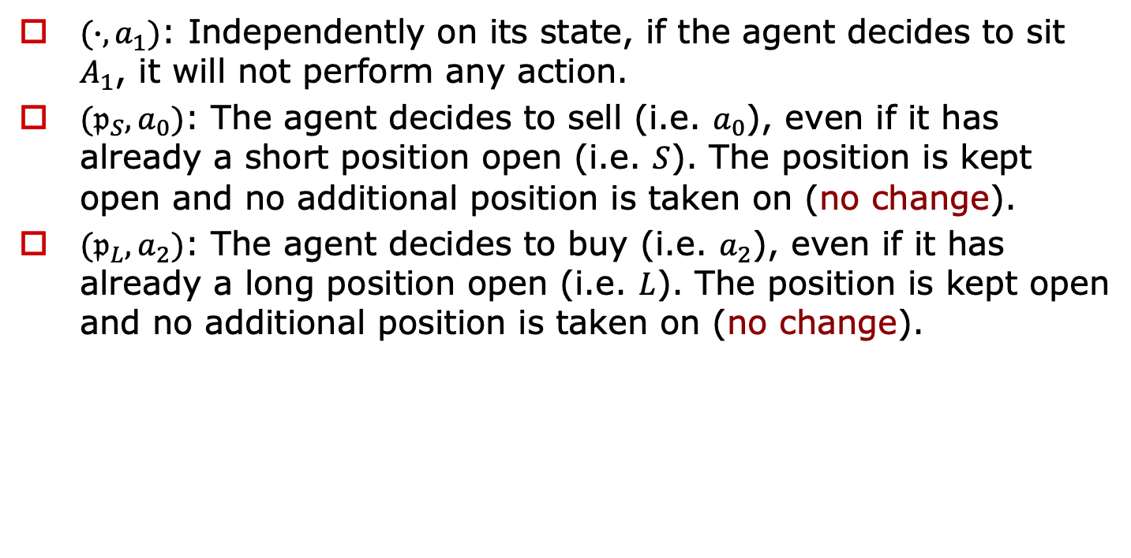
Methods – Models (4/5)
$(∙,a_{1})$: Independently on its state, if the agent decides to sit $A_{1}$, it will not perform any action.
$(𝔭_{S},a_{0})$: The agent decides to sell (i.e. $a_{0}$), even if it has already a short position open (i.e. $S$). The position is kept open and no additional position is taken on (no change).
$(𝔭_{L},a_{2})$: The agent decides to buy (i.e. $a_{2}$), even if it has already a long position open (i.e. $L$). The position is kept open and no additional position is taken on (no change).
$$A={\left\{a_{i}\right\}}_{i=0}^{3}= \{sell, stay, buy, daily_stop_loss\}$$
$$𝒫= \{𝔭_{i}\}_{i∈N,L,S}=\{neutral,long,short\}$$

Slide 13
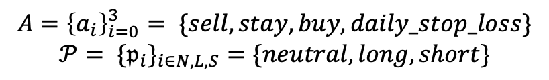
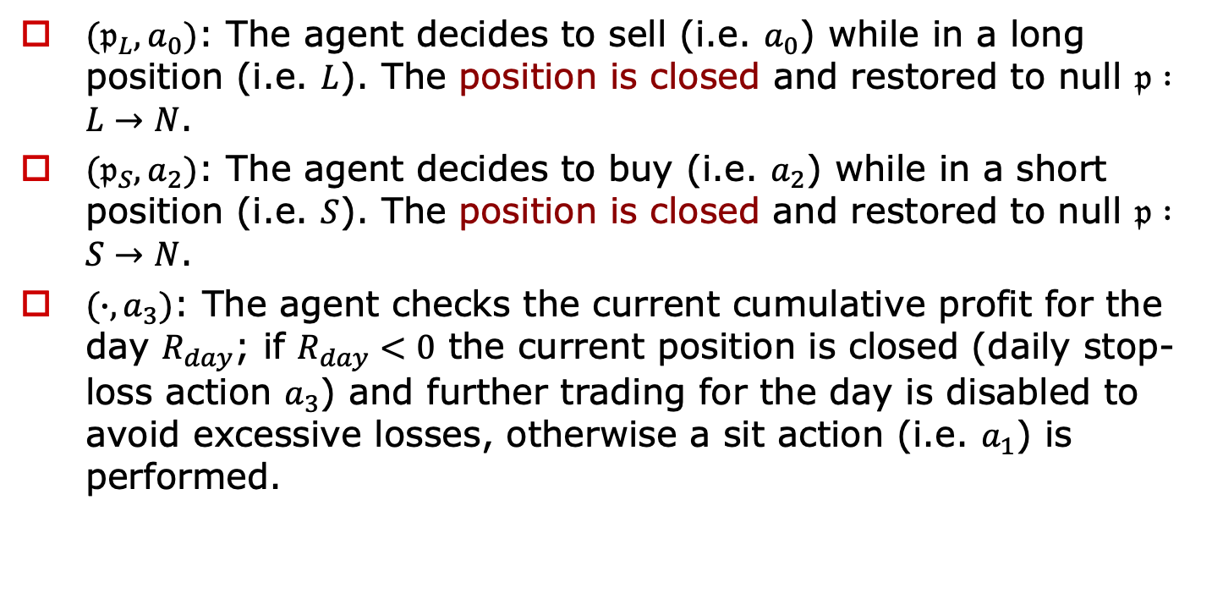
Methods – Models (5/5)
$(𝔭_{L},a_{0})$: The agent decides to sell (i.e. $a_{0}$) while in a long position (i.e. $L$). The position is closed and restored to null $𝔭 :L→N$.
$(𝔭_{S},a_{2})$: The agent decides to buy (i.e. $a_{2}$) while in a short position (i.e. $S$). The position is closed and restored to null $𝔭 :S→N$.
$(∙,a_{3})$: The agent checks the current cumulative profit for the day $R_{day}$; if $R_{day}<0$ the current position is closed (daily stop-loss action $a_{3}$) and further trading for the day is disabled to avoid excessive losses, otherwise a sit action (i.e. $a_{1}$) is performed.
$$A={\left\{a_{i}\right\}}_{i=0}^{3}= \{sell, stay, buy, daily_stop_loss\}$$
$$𝒫= \{𝔭_{i}\}_{i∈N,L,S}=\{neutral,long,short\}$$

Slide 14
Methods - Training-Test Pipeline (1/3)
For each one of the 82 available trading days, 5 LOB snapshots of 104 consecutive ticks each are selected.
only 25 snapshots are sampled and transformed into vectorised DRL environments.
Each environment is then run over 30 epochs.
The underlying agent’s policy network is represented by a simple Multilayer Perceptron which consists of two hidden layers of 64 neurons each, shared between the action network and the value network.
The last hidden layer is then mapped directly to the two final single-valued network outputs (action and value).
[10] A. Hill, A. Raffin, M. Ernestus, A. Gleave, A. Kanervisto, R. Traore, P. Dhariwal, C. Hesse, O. Klimov, A. Nichol, M. Plappert, A. Radford, J. Schulman, S. Sidor, and Y. Wu, “Stable baselines,” https://github.com/ hill-a/stable-baselines, 2018.
Notes:
訓練階段：
使用持續學習方法對82個交易日進行學習。在每個交易日中選擇5個限價訂單簿（LOB）快照，每個快照包含104個連續的交易信息。這些快照被選中是因為它們包含了當日中點價格變化的最大絕對差值，這樣的數據具有高信噪比，變化更有可能被實際操作。
從這些快照中隨機選擇25個，並將它們轉換為向量化的深度強化學習環境。
每個環境運行30個時代。使用的深度強化學習代理的策略網絡是一個簡單的多層感知器，具有兩個隱藏層，每層64個神經元，這些層在動作網絡和價值網絡之間共享。最後一個隱藏層直接映射到兩個最終的單一值網絡輸出（動作和價值）。
超參數優化階段：
使用貝葉斯優化方法對模型的特定超參數（如學習率和熵係數）進行優化。這是在一個驗證集上進行的，其環境（即LOB快照）的選取方式類似於訓練集。
使用一個高斯過程回歸器，配合一個平方指數核來擬合將超參數值映射到樣本外獎勵的未知函數。基於在所有驗證交易日上註冊的累積利潤，下一個要評估的實現是通過利用預期改進函數迭代選擇的。擬合函數隨後產生用於訓練的最優超參數值。
測試階段：
通過代理學到的政策在測試集的所有日子上獨立測試。每次關閉倉位時更新累積每日利潤$R_{day}$，並記錄相應的獎勵以定義盈虧（P&L）軌跡。然後使用獲得的結果來比較不同狀態特徵對代理樣本外表現的影響。

Slide 15
Methods - Training-Test Pipeline (2/3)
Bayesian Optimisation
Gaussian Process

Slide 16
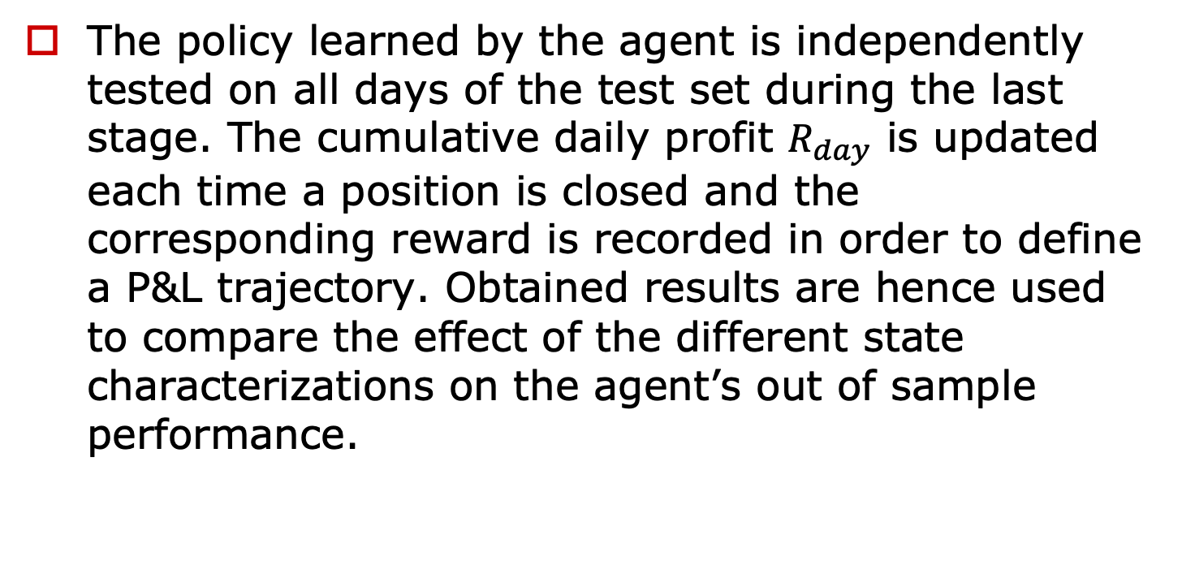
Methods - Training-Test Pipeline (3/3)
The policy learned by the agent is independently tested on all days of the test set during the last stage. The cumulative daily profit $R_{day}$ is updated each time a position is closed and the corresponding reward is recorded in order to define a P&L trajectory. Obtained results are hence used to compare the effect of the different state characterizations on the agent’s out of sample performance.

Slide 17
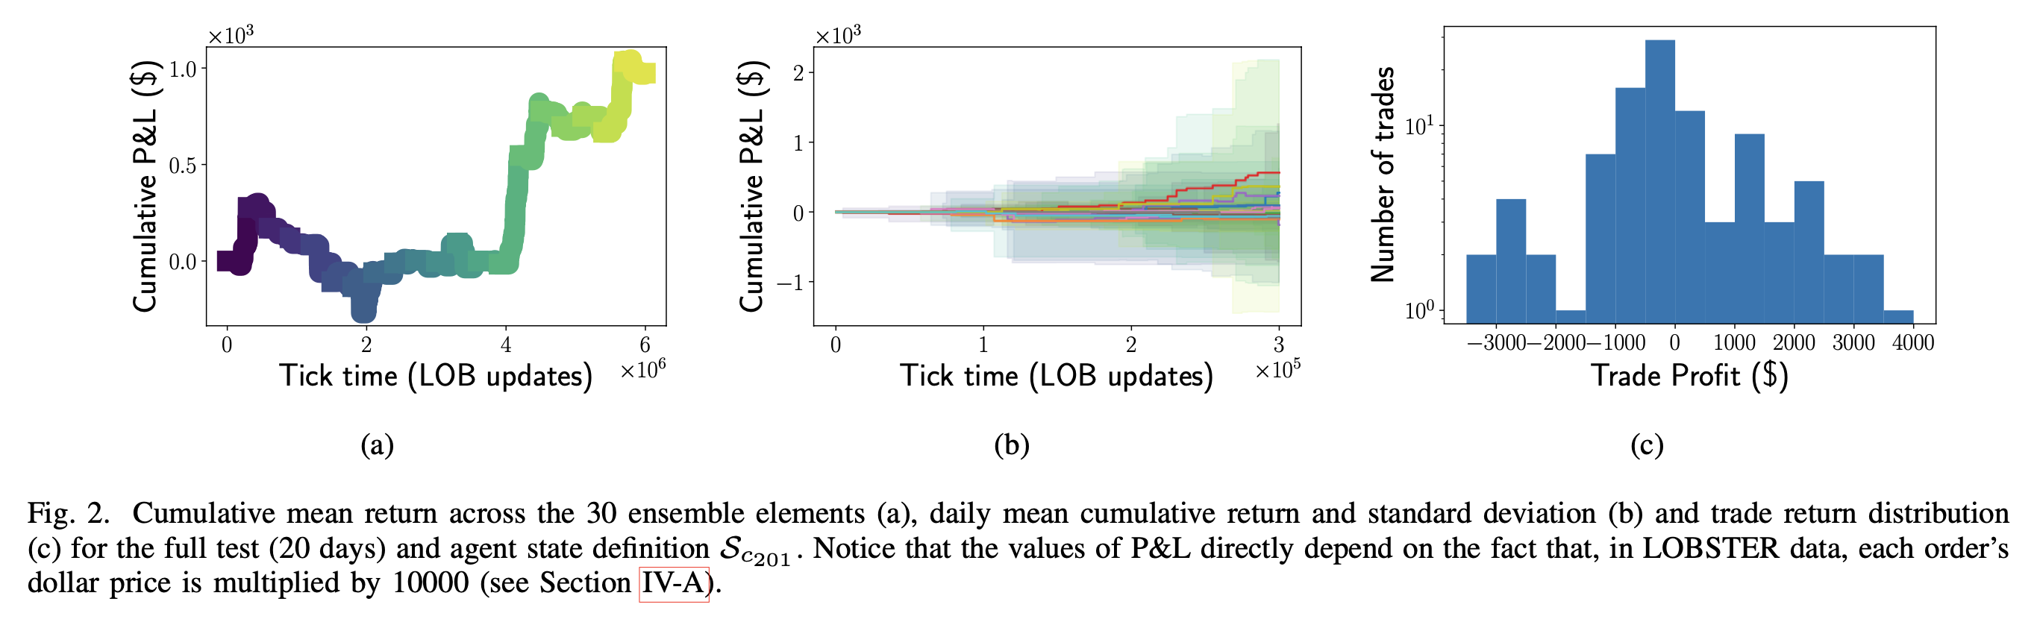
Results and Discussion (1/4)

Slide 18
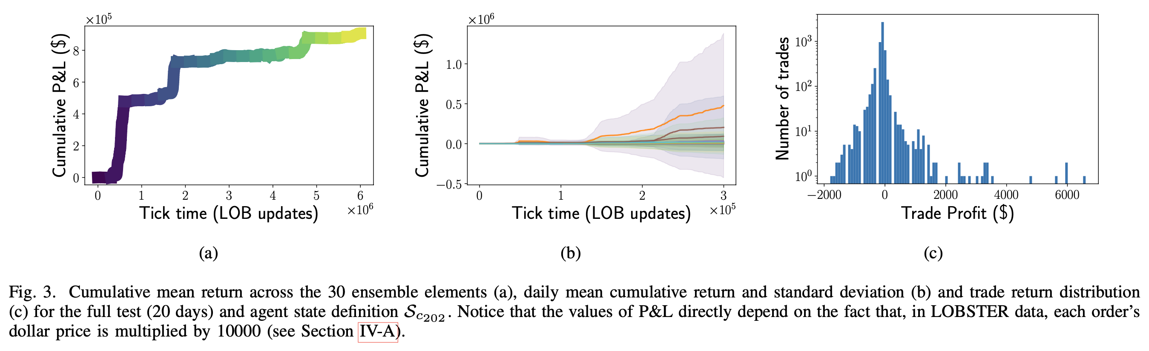
Results and Discussion (2/4)

Slide 19
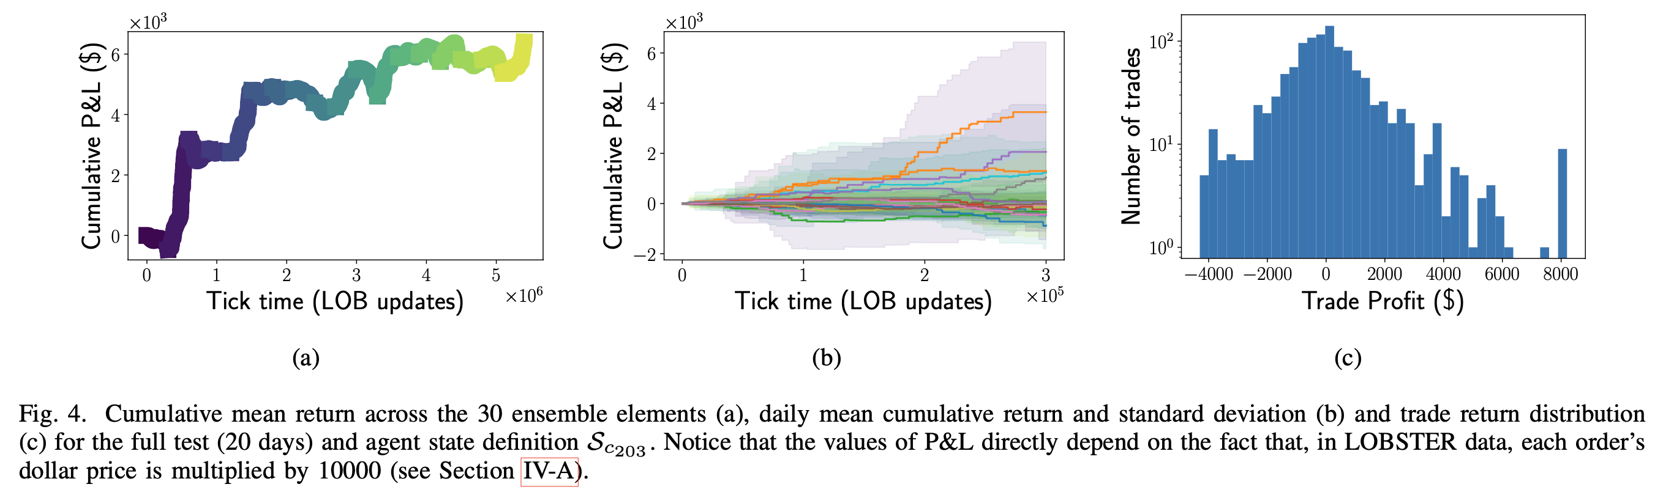
Results and Discussion (3/4)

Slide 20
Results and Discussion -Limitations (4/4)
sample inefficiency
The fact that the agent receives a reward only when closing a position means that feedback is only as frequent as the agent’s trade.

Slide 21
Conclusions
Investigate how three different state definitions affect the out-of-sample performance of the agents.
The knowledge of the mark-to-market return of their current position is highly beneficial both for the global P&L function and for the single trade reward.
a DRL agent can potentially perform well in a highly stochastic and non- stationary environment is worth noticing per se.
Notes:
這篇論文是從量化交易中在做回測時很容易發生OVERFITTING問題出發，希望可以利用GAN來學習到股價分布緩解OVERFITTING的問題，並且從實驗中得到一些結論，包括GAN可以學習到股價模型GBM的一些性質，樣本數在實驗中的重要性不是很大，用scaling可以緩解在資料生成階段的相關問題，以及GAN所學到的分布已經足夠在我們選擇一些策略時某些程度上避免overfitting的問題發生，更好的篩選策略等等。

